Slide 1


Water and Electricity Tracking App (PSC_110)
Presidency University
PIP4004 Capstone Project
Review-0
Batch Number: 118
Under the Supervision of,
Dr. Abdul Khadar A
Associate Professor
School of Computer Science and Engineering
Presidency University
Roll Number 20211CSE0636 20211CSE0699 20211CSE0658 | Student Name Soujanya S Badawadagi Bugga Iswarya Nirmala.R
Name of the Program: CSE
Name of the HoD:Dr.Asif Mohammed H.B
Name of the Program Project Coordinator: Mr. Amarnath J.L & Dr. Jayanthi. K.
Name of the School Project Coordinators: Dr. Abdul Khadar A

Slide 2
Introduction
Title :
Water and Electricity Tracking App (PSC_110)
Abstract:
This project is an Android-based tracking application that helps users monitor their current water and electricity usage in real time.
The app integrates Firebase Firestore to store and retrieve usage data, ensuring efficient and accurate tracking.Users can set predefined usage limits, and the app provides alerts when consumption exceeds these thresholds.
Graphical representations such as bar charts and progress indicators help users visualize their consumption patterns.
The goal of this application is to promote efficient resource usage by allowing users to track their current consumption, set predefined limits, and receive behavioral nudges through notifications."

Slide 3
Literature Review
Research Papers:
https://link.springer.com/article/10.1007/s43621-024-00618-3
https://papers.ssrn.com/sol3/papers.cfm?abstract_id=4264945
https://www.researchgate.net/publication/358795459_Analysis_of_Personal_Data_Visualization_Reviews_On_mHealth_Apps_short_paper
https://www.researchgate.net/publication/372971016_Understanding_User_Perspectives_on_Data_Visualisation_in_mHealth_Apps_A_Survey_Study
https://oaepublish.com/articles/jsegc.2020.03
https://pmc.ncbi.nlm.nih.gov/articles/PMC8584752/
https://link.springer.com/article/10.1007/s42979-023-02457-x
https://onlinelibrary.wiley.com/doi/10.1155/2021/3740476
https://www.ncbi.nlm.nih.gov/pmc/articles/PMC9738046/
https://www.sciencedirect.com/science/article/pii/S2352550922000874

Slide 4
Objectives
Current Usage Monitoring: Track the latest water and electricity usage dynamically.
Firestore Integration: Store and retrieve the latest usage data efficiently.
Usage Alerts & Notifications: Notify users immediately when their consumption exceeds a predefined limit.
Graphical Data Representation: Display usage insights using bar charts, pie charts, and circular progress indicators for better visualization.
User-Friendly Interface: Ensure a simple and intuitive Android app design for seamless tracking.
Encouraging Sustainable Practices: Provide instant feedback and motivational messages to promote efficient resource use.This keeps everything accurate while improving clarity. Let me know if you need more refinements!

Slide 5
Drawbacks
No Automatic Tracking – The app relies on manual data entry for water and electricity usage, which may lead to inaccurate tracking if users forget to update values.
Internet Dependency – Since Firestore is a cloud-based database, an active internet connection is required to store and retrieve data.
No Real-Time Updates – The app fetches data from Firestore only when requested, so updates are not reflected automatically unless reloaded.

Slide 6
Methodology
Development Tools:
Language: Java
Platform: Android Studio
Backend: Firebase for efficient data storage and synchronization.
Database: Firebase Firestore for securely storing and retrieving usage data.
Development Approach:
Requirement Gathering: Identify user needs and define essential app features.
UI/UX Design: Ensure a clean, intuitive interface for easy navigation and data visualization.
Backend Development: Implement tracking of water and electricity consumption using Firebase Firestore.
User Feedback: Collect early feedback, analyze user behavior, and refine the app for better performance and usability.

Slide 7
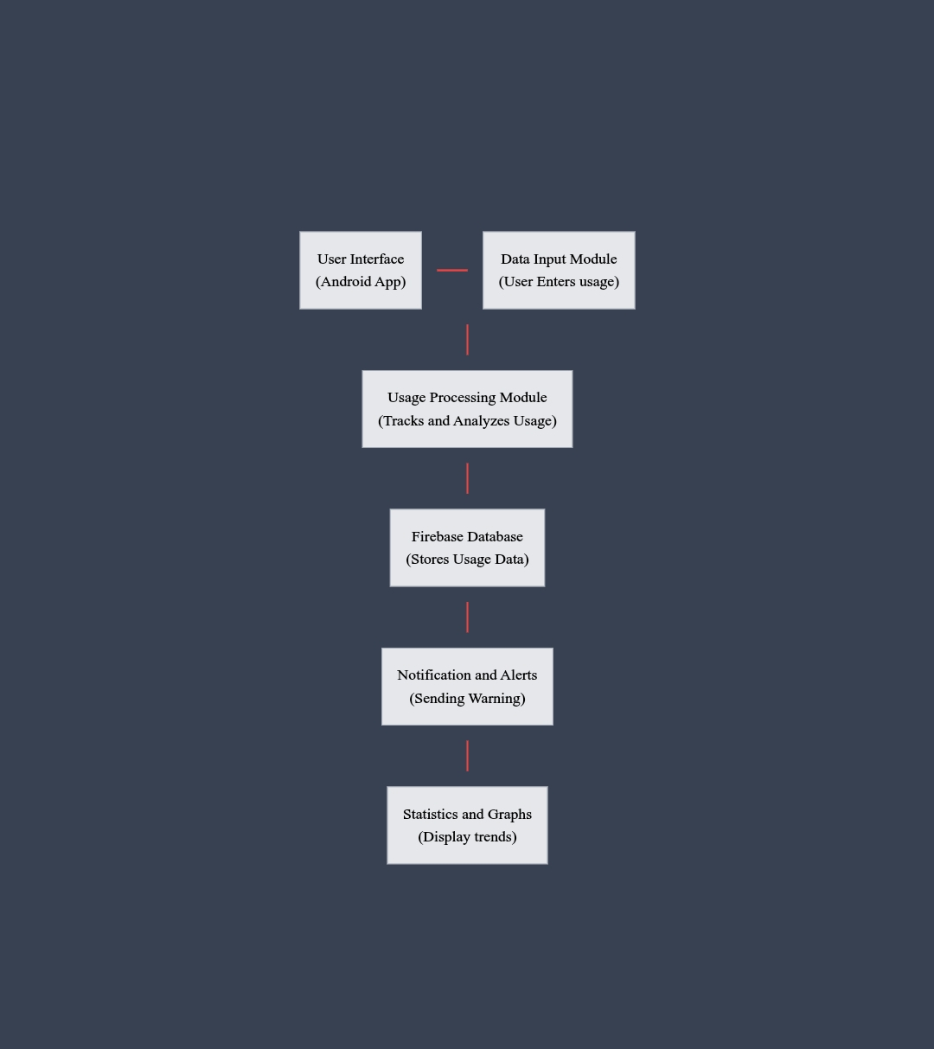
Architecture

Slide 8
Modules
Modules in the App
User Authentication Module – Handles user login/signup using Firebase Authentication.
Usage Tracking Module – Stores water and electricity usage data in Firestore for real-time monitoring.
Alerts & Notifications Module – Sends notifications when predefined usage limits are exceeded using Firebase Cloud Messaging.
Statistics & Graphical Analysis Module – Fetches usage data from Firestore and represents it in bar/pie charts using MPAndroidChart.
Settings & User Preferences Module – Allows users to set usage limits, notification preferences, and other configurations, stored in Firestore.

Slide 9
Hardware Requirements &Software Requirements
Hardware Requirements
Processor: Intel i5/i7 or AMD Ryzen 5/7
RAM: 8GB+
Storage: 256GB SSD+
OS: Windows 10/11, macOS,
LinuxInternet: Stable WiFi/Ethernet connection
Software Requirements
IDE: Android Studio Programming
Language: Java
Database: Cloud Firestore
Additional Tools: Firebase SDK, XML for UI designing.

Slide 10
Timeline of Project

Slide 11
References
IEEE Xplore: https://ieeexplore.ieee.org/document/XXXXXXX
Google Scholar: https://scholar.google.com/
ResearchGate: https://www.researchgate.net/
Energy Efficiency Research: https://www.iea.org/reports/energy-efficiency
World Bank - Water Conservation: https://www.worldbank.org/en/topic/water
MPAndroidChart Documentation: https://github.com/PhilJay/MPAndroidChart

Slide 12
Github Link
Github Link
https://github.com/Nirmala8645/Water-and-Electricity-Tracking-App-.git

Slide 13

Project work mapping with SDG

Slide 14
Thank You

